Slide 1




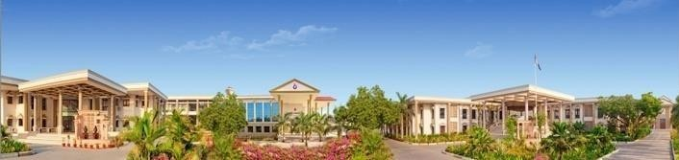





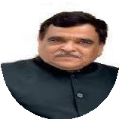

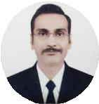

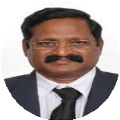



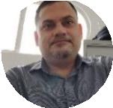


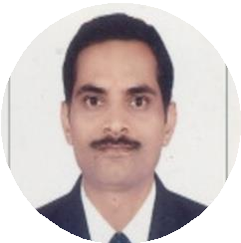
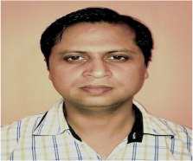

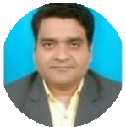
Batch-V
By
C.G. Bhakta Institute of Biotechnology
Duration : 15/12/2022 to 29/12/2022
( 2 hours per day, Total 30 hours)
Course Fee: INR. 700. Only
Eligibility
Any Bioscience/Pharmacy/Medical/Agriculture graduates, Post graduate and Research scholar.
Mentor
Dr. Dinesh R Shah , Provost, Uka Tarsadia University.
Resource Persons
Dr. Ravi Vijayvargia: Asst. Professor, Dept. of Biochemistry, The M.S. University of Baroda. Postdoc from UM DNJ-Rutgers University, New Jersey and MGH-Harvard Medical School, Boston USA.
Chair Person
Dr. Prof. R. Krishnamurthy, Director, C. G. Bhakta Institute of Biotechnology, Uka Tarsadia University.
Dr. Hem Chandra Jha, Aassociate Professor, IIT, Indore. Recipient of Ramanujan Fellowship
Coordinator and Resource Person
Dr. Gopal Jee Gopal. Asst. Prof. Uka Tarsadia University, PhD from Special centre for Molecular Medicine, JNU. He is CSIR-NET-JRF, D.S Kothari Post-Doc Fellow, Fast Track young Scientist (SERB,DST). Conducted 22 batches of online Recombinant DNA Technology Course and 4 batches of Genomics and Proteomics course
Mr. Ashwani Kumar Mishra: Founder of DNAXperts Pvt. Ltd. Noida
Dr. Bipransh Kumar Tiwary, HOD, Dept of
Microbiology, North Bengal St. Xavier’s college,
Rajganj. Jalpaiguri.
Registration
Deadline:
13th Dec.
Contact detail :
Dr. Gopal Jee Gopal (Co-ordinator),
Email Id: gopal.jee@utu.ac.in,
Cont No: 09558880617, 08160245501
Registration link : http://cgbibt.edu.in/RDTCourse.html
Follow us on LinkedIn: www.linkedin.com/in/gopal-jee-gopal-a2312529

Slide 2
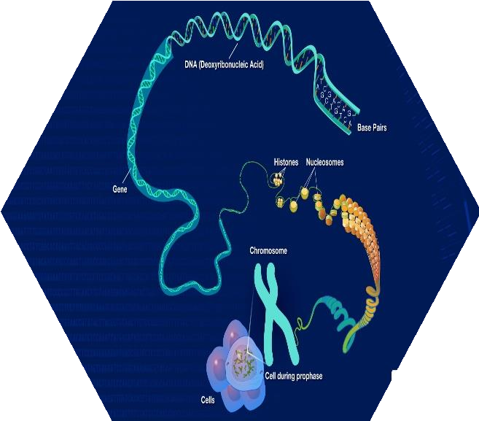



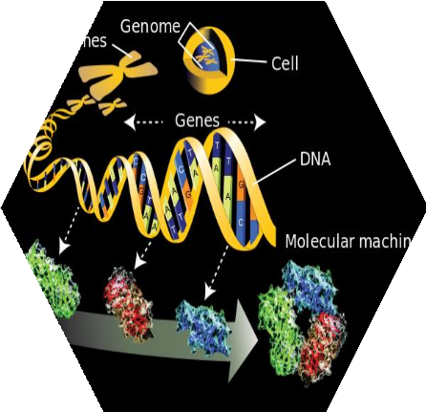




Course Details
Online Platform for Lectures:
Topics covered: Introduction to Genomics and Proteomics, Structure and Function of Nucleotide, Amino acid, DNA( Gene) and Protein, Gel electrophoresis for separation of DNA and Protein, Sequencing of DNA and protein, Protein purification and identification, Determination of targeted Gene expression and Global Gene expression, Post Translational Modification and analysis, Protein/Protein and Protein/ DNA Interaction.
Timing:
06.0 pm to 08.0 pm
Expected outcome: Participants will understand the basics of genomics and proteomics
and will be aware of about different techniques used in proteomics and genomics.
Note: You will Receive confirmation mail on 14/12/2022 (Morning), with instructions and Google meet link. Download the payment receipt after you pay the course fees and keep it with you.

